Slide 1
Final Term Report: VISUAL GAN
Prashant Khandelwal • Mentor: Yogin Patel

Slide 2
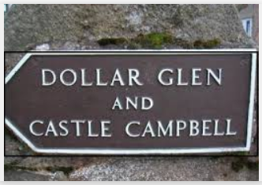
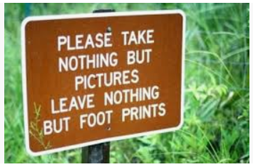
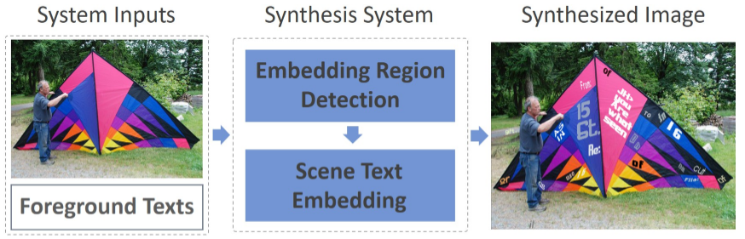
RECAP
PROBLEM: Scene Text Image Synthesis
Approach 1 Generate the whole image using GANs.
- Generating scene details in an image is itself a difficult problem.
Approach 2 Get non-text background images and embed text into the image.
- Formally known as Compositional GAN.

Slide 3
RECAP
Approach 2
Divided into three steps:
Finding suitable text-regions inside the image. => Region Detector
Embed the text into the text-region considering geometrical properties like scaling, translations, etc. => Geometry Synthesizer
Improve the appearance of the embedded text to fuse it into the background image. => Appearance Synthesizer

Slide 4

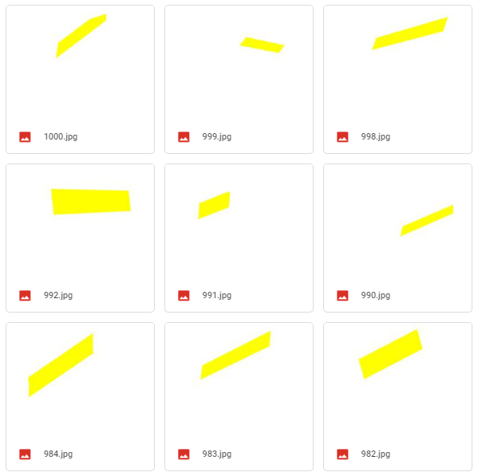
Foreground
Background

Slide 5
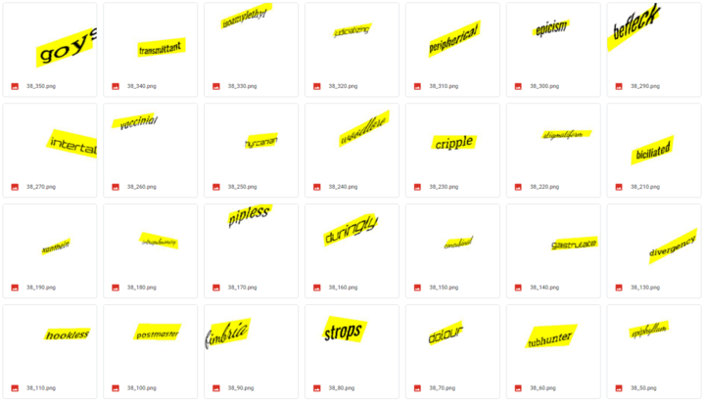
Output - Composed Image

Slide 6

Next Steps...
Improving training stability
Used Spectral Normalization, dropout and label smoothing
Improving original dataset and then applying the model to it
Appearance Synthesizer

Slide 7
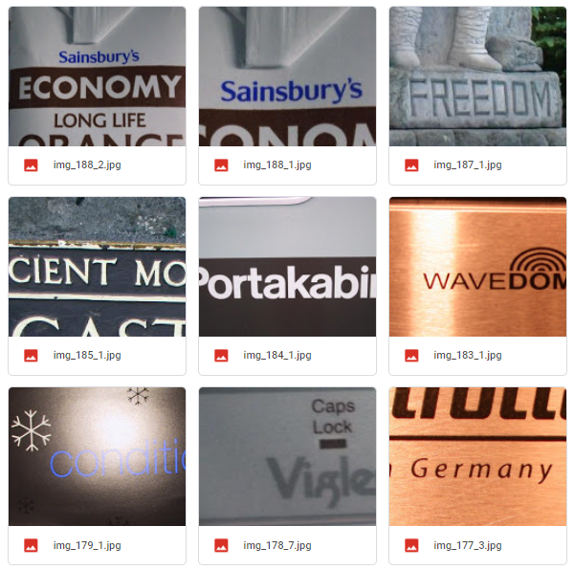
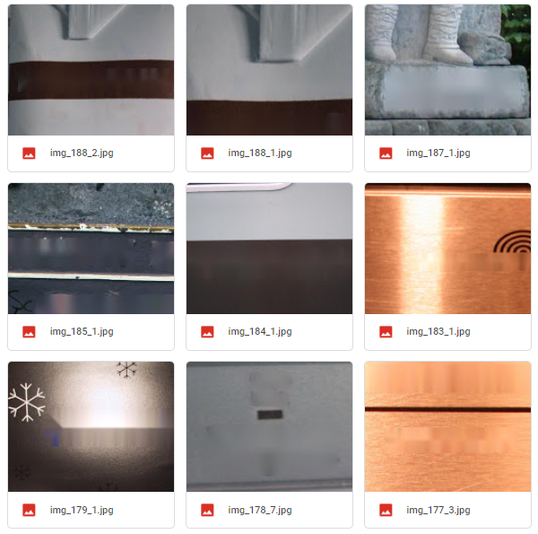
Original Dataset
Real
Background
- Image Inpainting
- Gaussian Blurring

Slide 8
Appearance Synthesizer
Motivation
Working
Implementation

Slide 9
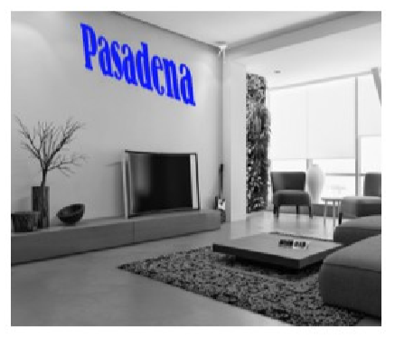
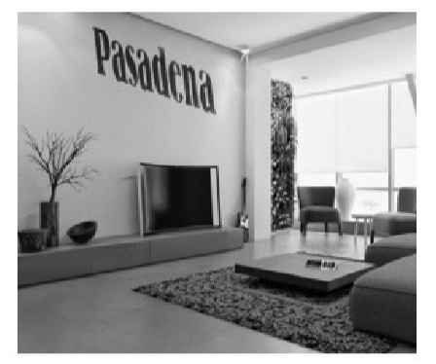
Motivation
It aims to fuse the foreground object and background image to achieve synthesis realism in the appearance space.
Without appearance Synthesizer
With appearance Synthesizer

Slide 10
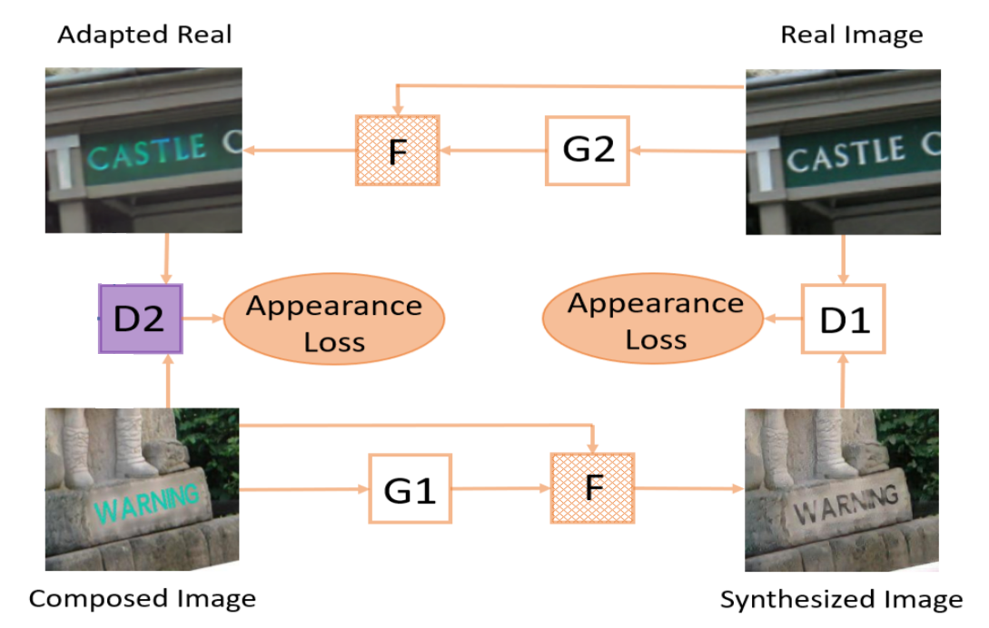
Working
CYCLE STRUCTURE

Slide 11
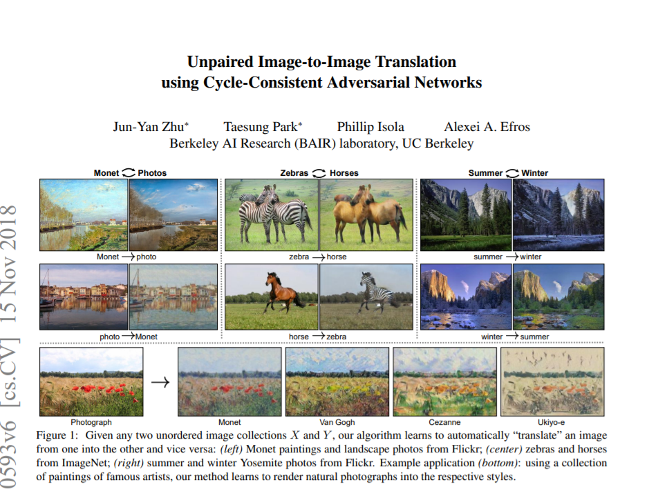

Slide 12
Working
X’
Z
CYCLE GAN
For Unpaired Image Translations
X
Z’

Slide 13
Losses
Identity Loss
To ensure that the translated image preserves features of the original image.
G1: X -> Z
Identity_loss = LL1( G1(z), z )
G2: Z -> X
Identity_loss = LL1( G1(x), x )
Cycle-Consistency Loss
To ensure that the image translation cycle will bring the input image back to the same image.
Cycle 1: X -> Z -> X
Cycle_loss = LL1( G2(G1(x)), x )
Cycle 2: Z -> X -> Z
Cycle_loss = LL1( G1(G2(z)), z )
Adversarial GAN Loss
To ensure that the image translation cycle will bring the input image back to the same image.
G1: X -> Z
pred_x = D1(G1(x)) GAN_loss = MSE( pred_x, real_label )
G2: Z -> X
pred_z = D2(G2(z)) GAN_loss = MSE( pred_z, real_label )

Slide 14
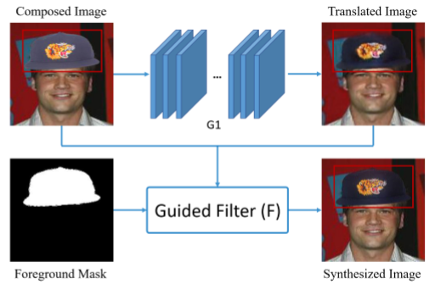
Guided Filters
Used to preserve details in image translations.

Slide 15
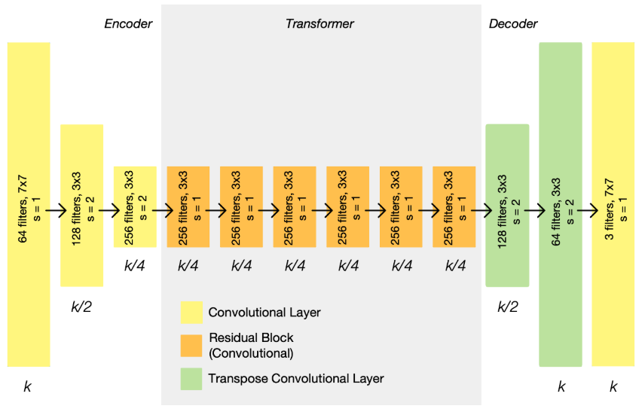
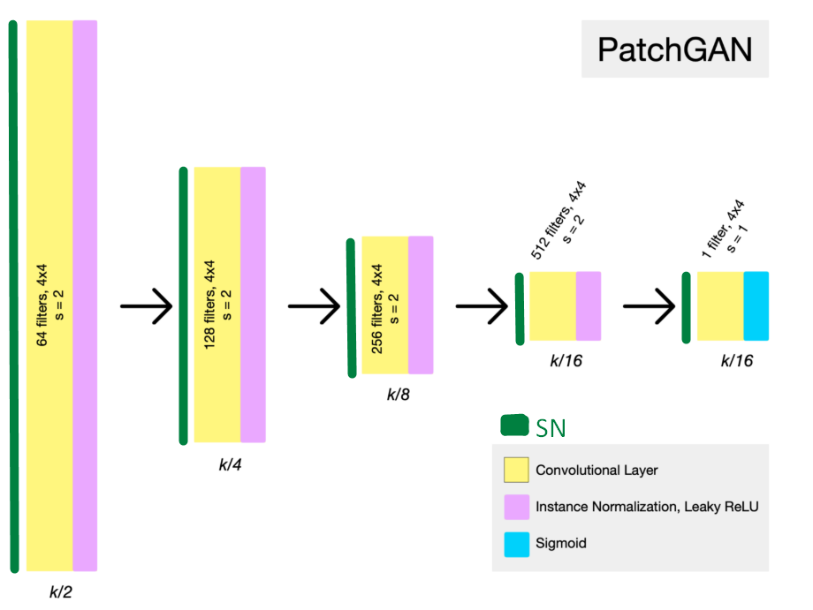
Implementation Details
Generator
Discriminator

Slide 16
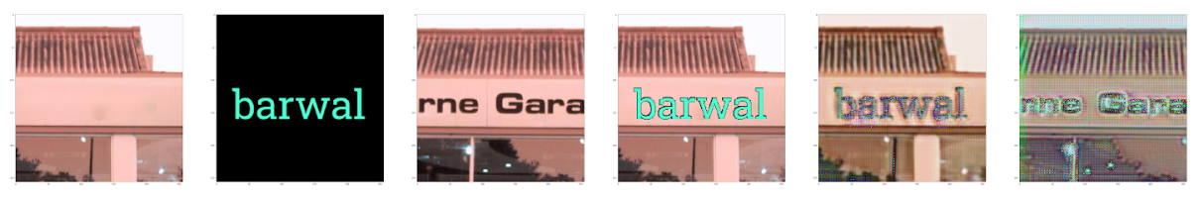
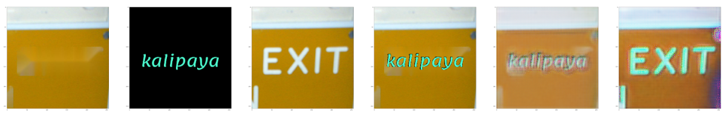
Output

Slide 17
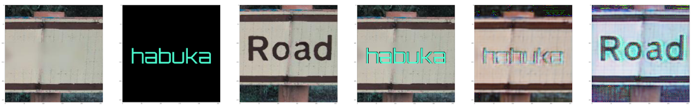
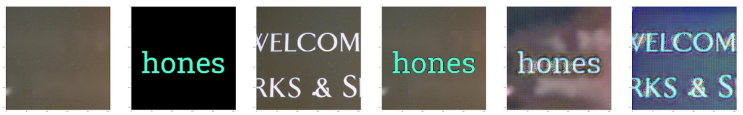
Output

Slide 18
Future Scope of the project
Adding a pre-trained resnet backbone to the generator.
Replacing the conventional Guided Filter with ‘Deep Convolution Guided Filters’
Adding a ROI detector in order to find suitable text-regions in the bigger background image to synthesize scene-text images with more than one text-masks.
Obtaining a better and bigger training dataset.

Slide 19
Links
Codebase [Google Drive]
Generated Dataset [Google Drive]
Outputs [Google Drive]

Slide 20
Questions ?

Slide 21
Thank You!

